Slide 1
Planning
Aneliya Kochneva, Cohort II Spring 2013

Slide 2
Town and Population Profile
Lincoln, MA
Location: west of Boston
Town profile: suburb
Median house value: $825,400.
Population: 6,362.
In proximity: Thoreau Institute, Massachusetts Audubon Society’s headquarters, deCordova Sculpture Park and Museum, Minuteman National Historical Park, Hanscom Air Force Base, and The Groves retirement community.

Slide 3
The Library
Lincoln Public Library*
Location: Lincoln, MA
Library staff: 15 full time employees, 51 volunteers, 3 part-time seniors
Library operating budget: $805,857
Visitors per year: 86,000
Library collection: 105,00
Circulation per year: 177,000
Services: Adult and children programing, gallery exhibitions, interlibrary loan, 2 million items in and out of network, Historical Room and Vault etc.
Notes:
Note: Lincoln Public Library is a real existing library, however the circumstances the name and location are used are entirely fictitious.
Image: http://commons.wikimedia.org/wiki/File:Carnegie_Free_Library_Building_In_Thames.jpg

Slide 4
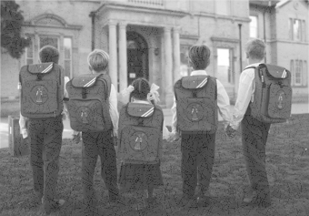
The Story
Six months ago a new private school ( Brown school) for children with special needs opened in close proximity with the library. This day-school is focused on working with students with learning disabilities in reading and writing, such as dyslexia.

Slide 5
The problem
The library covers the American Library Association’s ( ALA) basic requirements on accessibility for
people with disabilities. However, the library staff and patrons expressed a concern that the resources and services available at the library are inadequate to successfully accommodate Brown school’s children and their families’ needs ( programs, services and equipment ).
Questions are raised on how to serve the growing children’s with disabilities community better.

Slide 6
The Library’s Response:
Create a planning committee
Create a plan using issue-based tactical planning
Involve the community, seek public opinion and feedback, gather information on changing needs
Evaluate available resources, identify areas for improvement
Create goals and objectives as part of the planning process
Analyze the community feedback
Take action

Slide 7
Tactical Planning
What is tactical planning?
“ A systematic determination and scheduling of the immediate or short-term activities required in achieving objectives of strategic planning.“
(BusinessDictionary.com, 2013)

Slide 8
Planning Model: Issue-Based Planning
What is Issue-Based Planning Model?
Planning model that:
Identifies issues in the organization currently.
Addresses issues as questions
Requires to create a timeline ( action plan with listed responsibilities and people involved, timeframe)
Requires external and internal evaluation of the problems, processes and practices.
Requires to create a short term plan ( less than 2 years)
The library staff used this model with past problems
Notes:
Resource: http://soltisconsulting1.wordpress.com/2012/06/14/strategic-planning-issue-based-planning-part-6/

Slide 9
Why this model?
Issue-based model is appropriate to use because:
The problem that is being solved is existing, not anticipated.
The library is focusing on an current issue that has to be solved in a short timeframe ( as soon as possible)

Slide 10
Planning process timeline Sept. 2013-Dec. 2014
Goal 1 Library users will be made aware of the initiative the library is starting to improve the services and resources available for people, and especially children with learning disabilities, and will participate in it.
Strategy | Actions | Assigned to | Priority | Beginning | End
1. Increase awareness by exposure to the facts, problems and give opportunity to participate. | 1. The library will organize face-to-face interaction with the community ( focus groups, community open houses,. Discussion groups) | Assistant Director of Public Service | High | Sept. 1, 2013 | Feb 25, 2014
 | 2. The library will organize remote interaction s with the community ( online and paper survey, community forum) | Collaboration of Public Relations officer and IT department head. | High | Sept 1, 2013 | Feb. 25, 2014
Goal 2 The library will use the results from the user participation in Goal 1 to understand better the needs of the changing population in he area and improve the existing resources and services to accommodate the same population.
1. The library staff will create a committee that will be responsible to process, and assess the results from Goal 1. actions | 1. Create and supervise a committee to oversee the process. | Library Director | Medium-High | Sept 1, 2013 | Sept 1, 2014
 | 2. Assess the results of Goal 1 actions. | Committee members | Medium-high | Sept 1, 2013 | Sept 1, 2014
2. The library committee will provide the library administration and the public with progress reports | 1.Create and distribute progress reports internally and externally. | Committee members | Medium | Sept1, 2013 | Feb.25, 2014
3. The library committee will evaluate the available resources and suggest solutions. | 1. Deliver evaluation of resources report to the committee supervisor ( Library director) | Committee members | Medium | Nov. 1, 2013 | Dec.1, 2013
 | 2. Deliver suggestions report to the committee supervisor ( Library director) | Committee members | Low | Dec.1, 2013 | March 1, 2014
Goal 3 The library will make the suggested by the committee changes to improve the library experience for the changing community.
1. The library staff and administration will support the changes suggested by the committee | 1. Implement suggested and approved changes in the library to support Goal 1 and Goal 2. | Library staff and administration | Low | Sept. 1, 2014 | Dec. 2014

Slide 11
How to create a diverse survey group?
Reach out to Brown school’s administration to support the library initiative and encourage parents and students to participate. Provide surveys and invitations for the events.
Reach out to The Grove senior center (people with learning disabilities reside in it), provide printed surveys.
Contact local public schools and inform them about the initiative, provide printed surveys.
Reach out to the Student Support Services Committee in the Lincoln School District for support.
Advertise the initiative on the library website and community board.
Reach out to the local Bilingual non-profit organizations (often bilingual children experience language related learning problems)

Slide 12
Importance of diverse groups
Diverse survey groups are important because:
They provide unique social, cultural and economic perspective on issues.
Diverse personal perspective can be very inspirational and promote fast action.
Ideas grow faster in environment rich in differences in personality, age group, lifestyle, goals etc.
It promotes acceptance of differences and changes in different social segments.

Slide 13
How to get people involved?
Approach | Community segment | Number | Beginning | End
Community open house (one day event) | Families and children from Brown school, any other interested party from the community | 2 | (1)Sept. 1, 2013 | (2)Dec. 1, 2013
Public forum (on topic) | General population | 1 | Sept. 1, 2013 | ongoing
Discussion groups(one day events) | Brown school community, local government representatives, community members, special needs committee etc. | 2 | (1)Sept. 29, 2013 | (2)Oct. 30 2013
Community survey (printed brochures) | General population | 2 | (1)Sept. 1, 2013 (2) Dec 10, 2013 | (1)Nov. 29, 2013 (2) Feb.10, 2014
Community survey (online) | General population, mostly targeted towards the younger crowd though. | 2 | (1)Sept. 1, 2013 (2) Dec. 10, 2013 | (1)Sept. 1, 2013 (2) Dec. 10, 2013
Focus group ( one day event) | Parents, students, alumni, teachers, local government reps, school district reps, non-profit organization for people with disabilities (reps) | 2 | (1)Nov. 10, 2013 (2)Feb. 10, 2014 | ---

Slide 14
Assessment tools
To measure the effectiveness of the planning
process including community members with
diverse background to participate, the library will use the following assessment tools:
A Community open house at the end of the planning process.
Why? Provides personal connection face-to-face with patrons and stakeholders.
A Community survey - online and printed brochures distributed as described prior.
Why? Provides convenient for the patrons way to communicate their opinion.
Focus group at the end of the planning process
Why? Provides diverse feedback on a narrowed assessment scale.

Slide 15
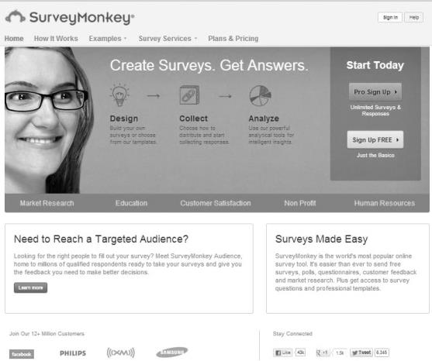
Assessment Tool (example)
The Community Survey’s online version will be performed
with the help of the website http://www.surveymonkey.com.
The questionnaire will include 15 questions that will provide:
Overview of the participant’s profiles ( who they are, what they like, what they need, etc).
Overview of the participants opinions on the library and it’s services.
Open format questions to harvest ideas on improvement.

Slide 16
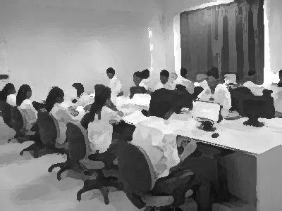
Progress communication
Planning committee report at the
end of the initiative.
Second open house event ( face-to-face interaction with stakeholders
Website updates (the planning process will be represented online, any interested party can received the required information)
Kick Off celebration (at the end of the initiative a party will be organized to promote the changes and updates that the library made to accommodate the juvenile population with learning disabilities’ needs.

Slide 17
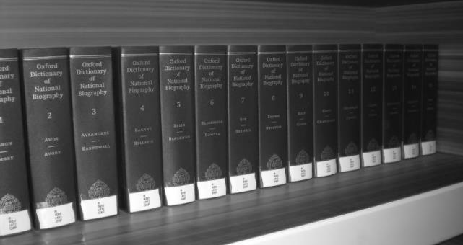
References
American Library Association (2001 ). Library Services for People with Disabilities. Official ALA website. Retrieved from: http://www.ala.org/ascla/asclaissues/libraryservices
American Library Association (2000 ). Facts: Why and ALA Disability Policy? Why Now? Library Services for People with Disabilities. Official ALA website. Retrieved from:. http://www.ala.org/ascla/asclaissues/factsheetabout
American Speech-Language-Hearing Association ASHA( 2013). Official website. Retrieved from: http://www.asha.org/public/speech/disorders/lbld.htm
Apple Inc. ( 2011) Financial and Strategic Analysis Review. Retrieved from UB Learns (https://ublearns.buffalo.edu/bbcswebdav/pid-2597447-dt-content-rid-4684178_1/courses/2131_19311_COMB/APPLE%20SWOT.pdf)
Business Dictionary ( Unknown) Tactical Planning Definition. Business Dictionary Website. Retrieved from: http://www.businessdictionary.com/definition/tactical-planning.html
Guder, C. (2010). Equality Through Access: Embedding Library Services for Patrons with Disabilities. Public Services Quarterly, 6(2/3), 315-322. doi:10.1080/15228959.2010.499324
Lincoln Public Library( Unknown) Official library website. Retrieved from: http://www.lincolnpl.org/

Slide 18
References Cont’d
Moxlet, D.P( 2004). Factors influencing the successful use of vision-based strategy planning by nonprofit human service organizations. International Journal of Organization Theory and Behavior, 7, 107-133.
Sharp, Z. & Blrock, D.M.,(2012) Implementation Through Risk Mitigation: Strategic Processes in the Nonprofit Organization Administration & Society 44(5), pp 571-594
Soltis Consulting (2012) Strategic Planning: Issue- Based Planning. Soltis Consulting official website. Retrieved from: http://soltisconsulting1.wordpress.com/2012/06/14/strategic-planning-issue-based-planning-part-6/
Stone, M.M.,& Bryson, J.M ( 2000) Strategic management in the nonprofit sector, Handbook of strategic management 2 ed, pp. 790-763, New York, NY: Marcel Dekker
University of Washington (2013) Universal Access: Making Library Resources Accessible to People with Disabilities. University of Washington official website. Retrieved from: https://www.washington.edu/doit/UA/PRESENT/libres.html
White, L ( 2013) LIS 581 Lecture Week 10.
Willis, C.A, ( 2012) Library Services for Persons with Disabilities: Twentieth Anniversary Update. Medical Reference Services Quarterly. 31(1)

Slide 19
Acknowledgements
All images used in this presentation unless otherwise specified are acquired through Wikimedia Commons website (http://commons.wikimedia.org/wiki/Category:Images)

