Slide 1
Jeremiah Hall
Aneliya Kochneva
March 12, 2012
LIS 518
Dr. Judith Robinson
STORYBOARD Presentation Topic: Online & Distance Learning Students
The following is a general outline for our presentation with visuals and notations
concerning narration and the script as well as aspects that will be animated. The
order and structure proposed here are what we plan to follow in creating our
presentation video. We will also note supplemental materials as well. We plan to
present our video as a “mini movie” with cartoon graphics that are animated (the
basis of which you see as visual representations here.
Use the following key:
Narrator
Librarian
Student
Animation
Talking Points
Used to mark spots in presentation where viewers can look at the supplemental materials to learn more about what is being covered.
See Supplement

Slide 2
Introduction
Introduce the Presentation – Movie Title:
List our names and what class it is for
List goals including what we want people to learn from this presentation:
What technologies librarians can use to help online students.
Who provides some of these technologies.
Including where these technologies are available (supplemental materials)
Illustrate some examples of using these technologies
General understanding of basic guidelines for online reference
Basic etiquette for online communication
**The goals will be animated like a movie opening title sequence (e.g. Star Wars)**

Slide 3
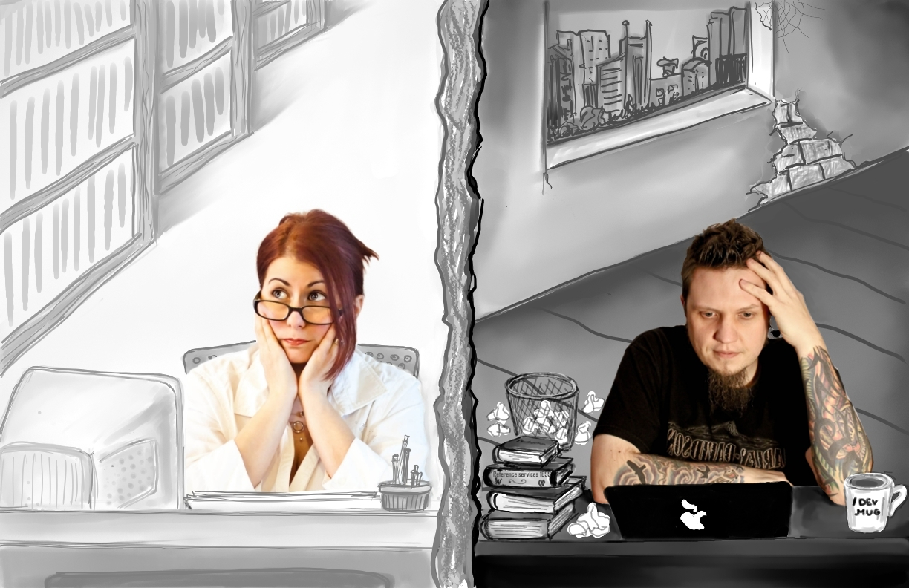
Scene 1
Introduce problem and ”characters…and start telling the story:
Narrator: It’s a dark and stormy night, a student sits in his apartment troubled that he cannot find what he is looking for. He needs help…a librarian’s help. Meanwhile a Librarian sits in a quiet library frustrated at not being able to think of a way to help the
students who cannot visit the library. She has been hearing whispers about the lack of
online reference services at the library. She needs help to provide help…
**Animate thought bubble pops up during narration**
Add sound effects and voices to reading bubble thoughts (to introduce character voices)

Slide 4
Scene 1
Solutions
Narrator: The answer to both of their problems comes in a message from the depths of the
enchanted world of online communication. A message that provides fantastic results with
real world solutions...
**Animate light bulb blinking on**

Slide 5
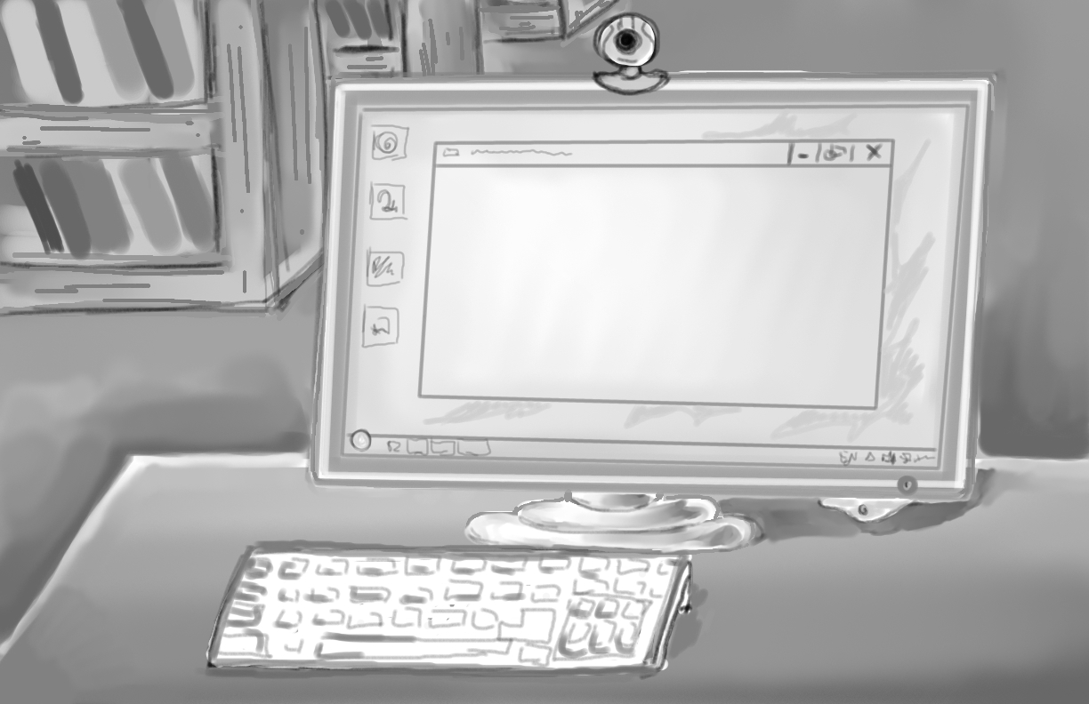
Scene 2
Email Reference
Narrator: Using email for reference is one option…
**Animate lines of text in email on screen**

Slide 6
Scene 2
Email Reference (cont’d)
Librarian: Of course! Setting up an email address for reference or creating an online email form that collects reference questions from patrons is a great solution.
Note: *This slide will have a different image

Slide 7
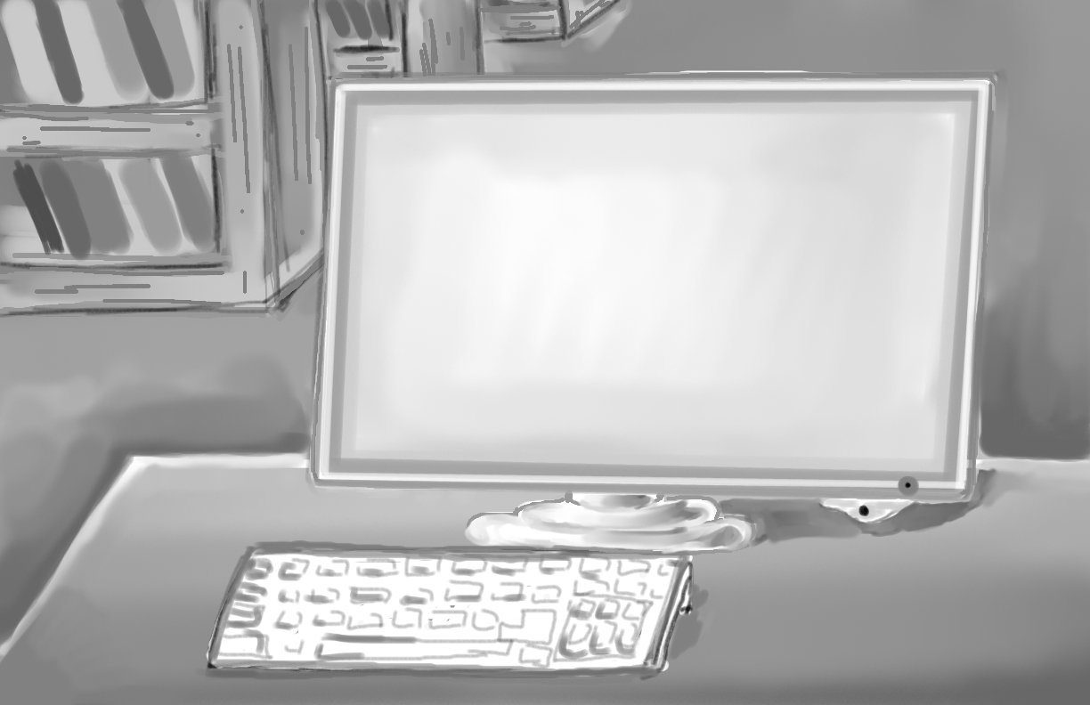
Scene 3
Chat Reference
Narrator: Synchronous online communication...Online chats can help provide reference to remote users. Packaged solutions like QuestionPoint and Libraryh3lp can be purchased for
nominal costs and are easy to setup for handling library-specific chats…
See Supplement
**Animate lines of text in chat window and popup logo for Libraryh3lp & QuestionPoint**

Slide 8
Scene 3
Chat Reference (cont’d)
Narrator: Users can also send instant messages through chat systems like Libraryh3lp…They
can use a variety of instant messaging services including AOL Instant Message (AIM)… MSN Messenger…Yahoo Chat…or any XMPP/Jabber compatible service…also
See Supplement
**Animate popup of logos as they are noted by narration**

Slide 9
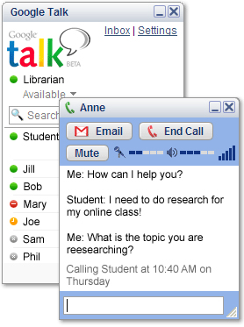
Scene 3
Chat Reference (cont’d)
Narrator: Google Talk…Easy, reliable, and most of all free…
Librarian: No way! I didn’t even know Google Talk had a video chat as well!
Narrator: Yes, way. You would be surprised how many ways you can
communicate with patrons from a distance…You can even video chat with Skype! Student: I can Skype with a librarian? That’s easy.
See Supplement
**Animate Google Talk window and logo**

Slide 10
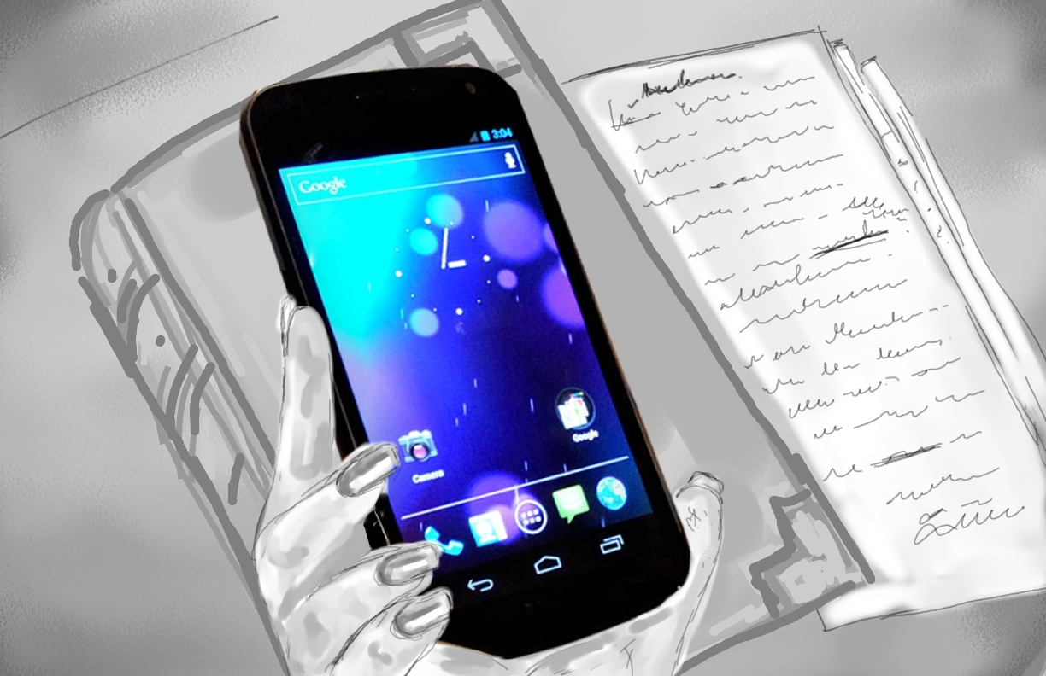
Scene 4
SMS Texting
Narrator: Another great way is text messaging...
Librarian: I can use that too?
Narrator: Absolutely. Providing a cellphone for librarians to use or purchasing software
that converts incoming text messages to emails is very convenient…There are also
library specific services that can be used for SMS Reference like AltaRama and
Text a Librarian.
See Supplement
**Animate hand holding cellphone. Then popup logos of software.**

Slide 11
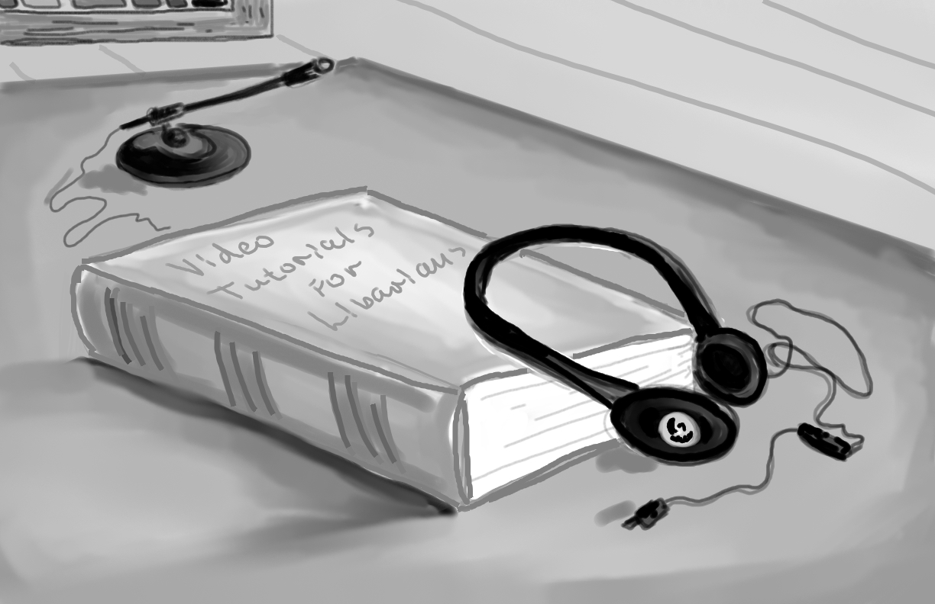
Scene 5
Video and Online Tutorials
Librarian: Yes, but patrons often ask the same questions over and over...
Narrator: No worries. The best way to demonstrate examples and provide detailed
instructions is making video or online tutorials for users…as well providing a list with
frequently asked questions.
Librarian: How can I do this?

Slide 12
Scene 5
Video and Online Tutorials (cont’d)
Narrator: Use Microsoft Power Point to create a presentation and convert it to html…[animate
Power Point logo]
Narrator: You can also use Camtasia to create videos with voiceovers…[Animate Camtasia Logo]
Narrator: Or Microsoft Movie Maker and iMovie on a Mac to create videos…[Animate logos]
Narrator: You can create html files or even write out instructions in a Microsoft Word document to be converted to html by your web team. [Animate MSWord Logo and HTML]
See Supplement
**Animate logos and show short sample video of screen**

Slide 13
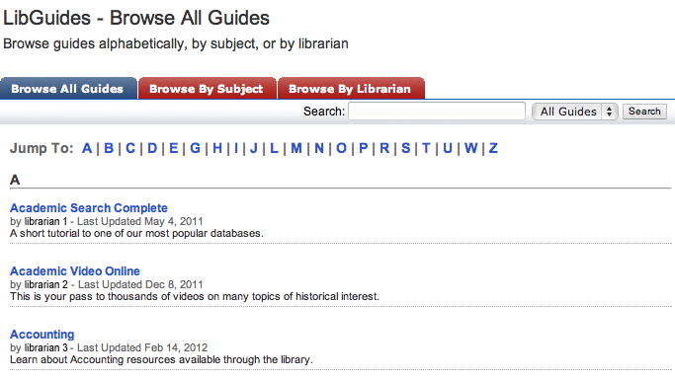
Scene 5
Video and Online Tutorials (cont’d)
Librarian: Yes, but students think using Wikipedia or Google is reference service!
Narrator: This is where you can help them with tutorials and instruction. You can create online pathfinders, research guides to help users get started, or you can pay for services like LibGuides which offer librarian designed portals with high quality research information.
See Supplement
**Animate logo and libguides picture.**

Slide 14
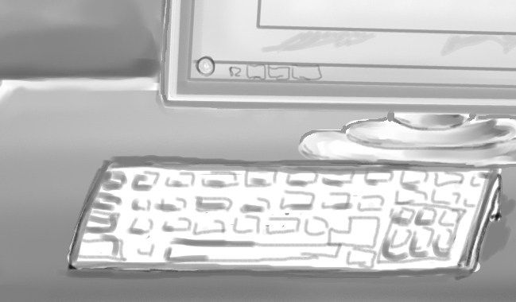
Scene 6
Screen Sharing/Screen Captures
Narrator: Librarians can also use screen sharing software or screen captures to enhance users experiences…
Librarian: Join(dot)me is a free online resource that allows me to share my screen with users. Also I can use things like Google Hangout for free and easy way to help the patrons that need me.
Narrator: Screen captures can be used to illustrate examples in tutorials or…can be emailed to
patrons. There is software available especially for this, but you can also use a simple command.
CMD+Shift+3 on a Mac and Print Screen key on a PC.
See Supplement
**Animate logo and screen sharing**

Slide 15
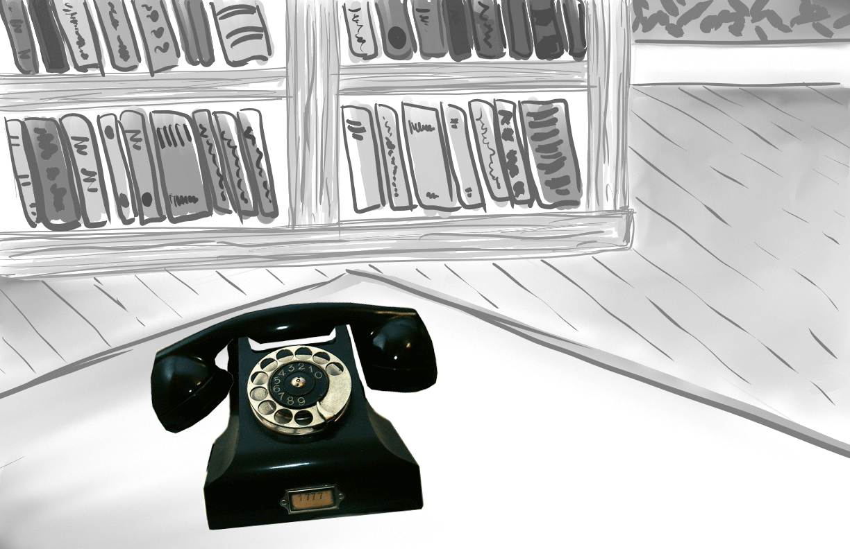
Scene 7
Phone
Narrator: But remember – you should always encourage the student to call for help. Librarian: (Answers phone) Hello this is the library, how can I help you? Student: I need help writing a paper for my online class…
**Animate phone with sound**

Slide 16
Scene 8
Summary of Resources
Narrator: As you see, online reference is easy, whether you use Email…Online (video) chat…Instant
Messaging…and even SMS text messaging to conduct a reference interview, you can always be in
touch with the online user who needs you. And the best way to give them a good start is creating
video tutorials and research guides so they can help themselves when you are not around… Librarian: Wow that’s a lot of options!
-Email Reference
-Chat and Video Chat
-IM
-SMS Texting
-Videos and Online Tutorials
-Research Pathfinders or Guides (LibGuides)
**Animate talking points over the background**

Slide 17
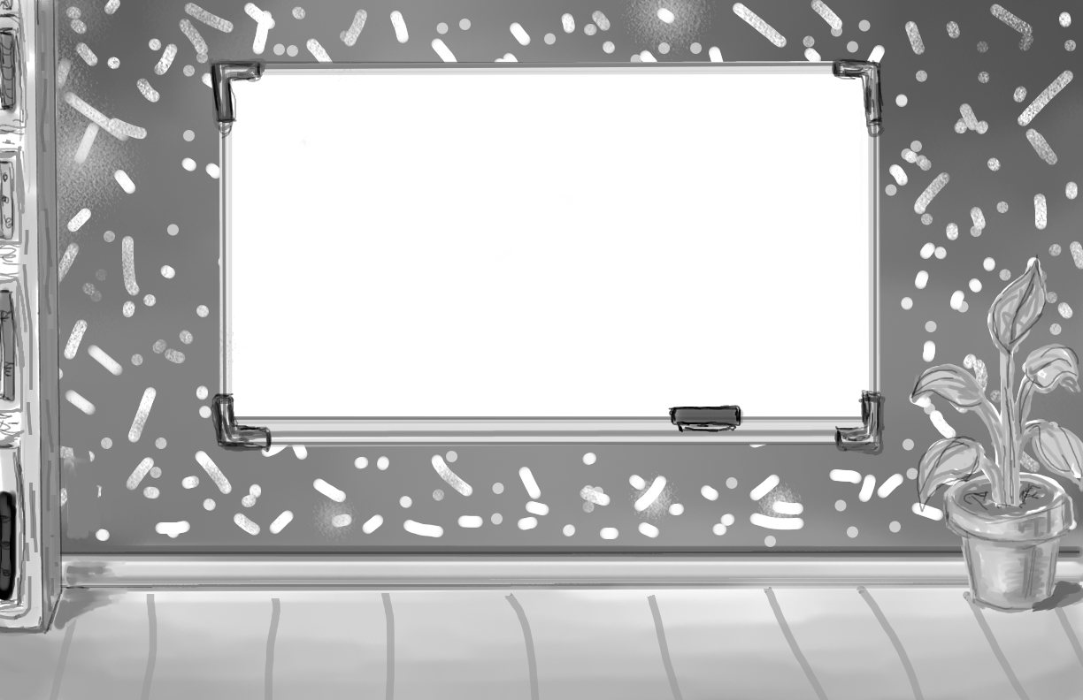
Scene 9
Guidelines and Etiquette
Librarian: Yes, but what if the online students would not use these services?
Narrator: You can help patrons to get comfortable with your online reference services by
following some basic rules and guidelines…
-Make sure your online reference services are highly visible on the library website.
Promote the services to students within the online classroom system through links
and explanations in introductory materials for students new to the programs.
-Brand reference services for better promotion – like “Ask a Librarian” which offers
all services in one place online.
See Supplement
**Animate talking points over the background**

Slide 18
Scene 9
Guidelines and Etiquette (cont’d)
Narrator: Also remember, time is of the essence with online reference, be prompt, be
courteous, be friendly!
-Establish contact with the patron in a timely manner.
-Send an initial reply acknowledging receipt of their inquiry – or at the very least
generate an automated response to tell the user you are working on their request.
-Ask open-ended questions and use online forms to collect pertinent info from
the patron if possible.
-Offer cordial and friendly responses
See Supplement
**Animate talking points over the background**

Slide 19
Scene 9
Guidelines and Etiquette (cont’d)
Librarian: People say it is easy to communicate online, but I am nervous, not seeing the face
of the person I am talking to.
Narrator: Chances are, the person at the other end is as nervous as you are about online
communication, but you can eliminate that worry by following some simple rules:
-Do NOT use ALL CAPS – This is perceived as yelling in online communication.
-Be familiar with, but avoid using “Netspeak” abbreviations like LOL, FYI, IMHO, OMG, BTW and so on.
-Don’t be afraid to ask a patron to clarify their question.
-Be polite.
See Supplement
**Animate talking points over the background**

Slide 20
Scene 9
Guidelines and Etiquette (cont’d)
-Point to specific resources the student can use. If you can offer a link to the location,
do it.
-Offer screen shots or use screen sharing software to demonstrate resources.
Librarian: Like I did with join.me?
Narrator: Exactly. You can always...
-Tailor your responses to the medium SMS Text messages have a 160 character limit
E-mails can be longer but be concise
Chat messages happen in real time and the user is waiting for your response.
-It is vital after the conversation to invite the users to follow-up on the phone or via email
if necessary.
See Supplement
**Animate talking points over the background**

Slide 21
Scene 10
Ending/Supplemental Materials
Librarian: Now I feel more confident about helping the users who can’t come to the library! Student: Now I can get the help that I need!
Note: * This slide will have a different image.

Slide 22
Scene 10
Ending/Supplemental Materials
Narrator: If you want to learn more about the resources and ideas discussed
here, see the supplement for additional info and links…( pause)…You gotta love happy endings!
(fade to black)
**Animate closing credits like a movie**
Note: * For the purpose of presenting the storyboard this week we have used only a
sample of the images the real presentation will include and that is the reason why
some of the slides for the storyboard are the same.

